Slide 1
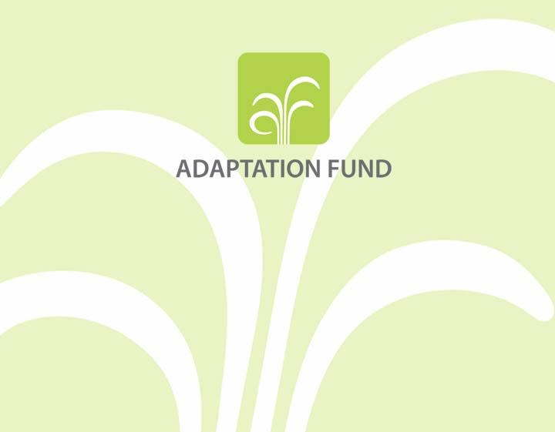
Transparency and the Adaptation Fund
Open Knowledge Conference
16 September 2013
Marc-Antoine MARTIN (AFBoard)

Slide 2
Outline of Presentation
Overview of Adaptation Fund
Commitment to Transparency and Accountability
Continuous Improvement

Slide 3
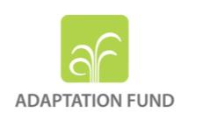
The Adaptation Fund was established under the Kyoto Protocol of the UNFCCC
Financed from a 2% share of the emission reduction proceeds on the Clean Development Mechanism project activities and other sources of funding (188 + 152 M$ as at March2013).
Governed by a Board (16 Members and 16 Alternates) of majority developing country members
The only climate adaptation fund that developing countries (/PK) are eligible to access

Slide 4
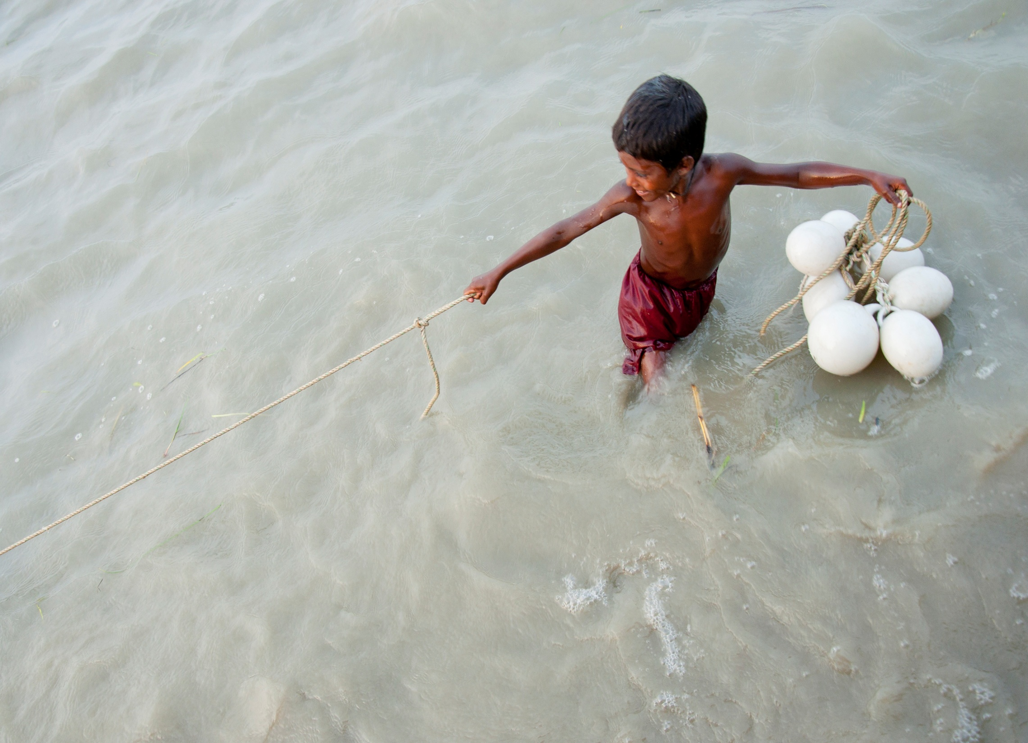
Achievements at March 2013
Direct access (15 NIEs , 10MIEs , 2RIEs)
Country-drivenness and use of country systems
Expedited decision-making
Enhanced transparency
Performance-based disbursements, and use of results-based management
Involvement of civil society at various levels

Slide 5
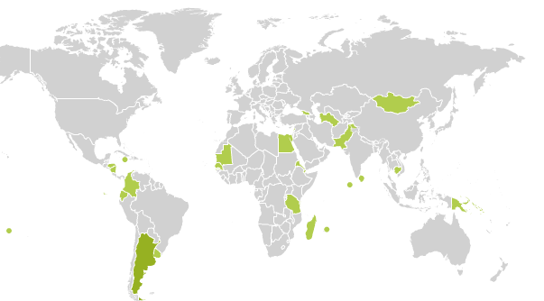
Since 2010 the Fund has approved 28 concrete adaptation projects in vulnerable developing countries
Interactive map: www.adaptation-fund.org

Slide 6
Outline of Presentation
Overview of Adaptation Fund
Commitment to Transparency and Accountability
Continuous Improvement

Slide 7
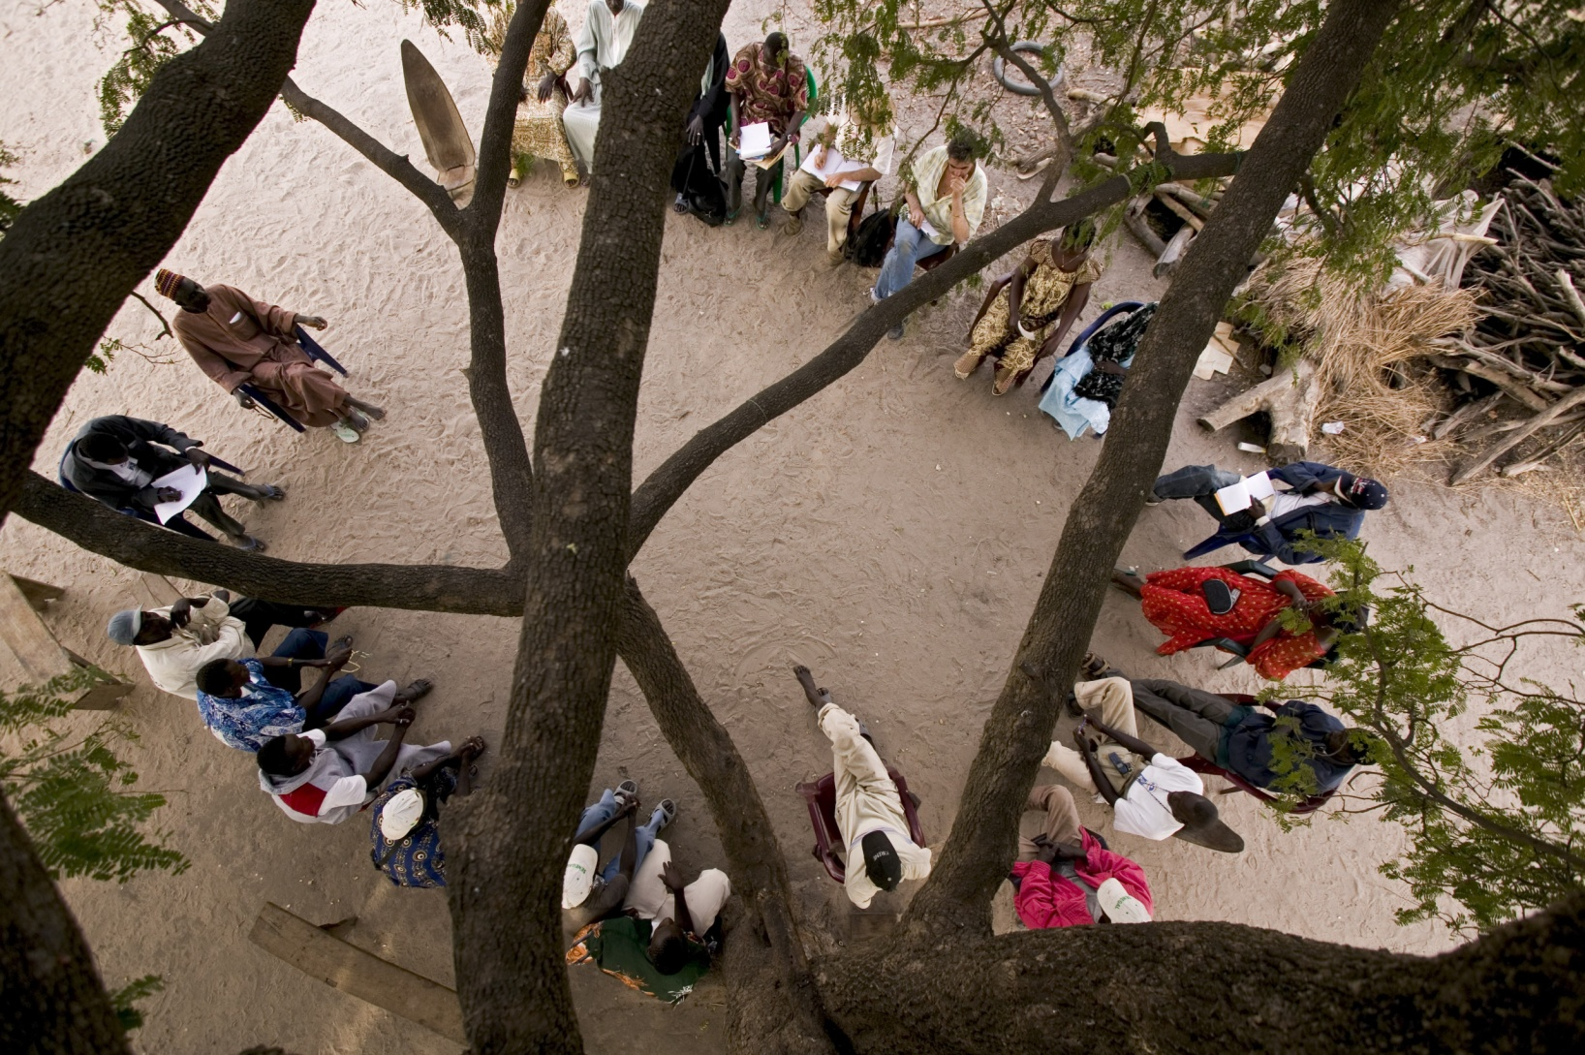
Transparency and Accountability
All Board documents posted online prior to meeting
All project and programme proposals received are considered and reviews disclosed
The Board makes and publishes in its meeting reports a decision about every proposal submitted
Possibility to comment on all proposals online before consideration by Board
All board meetings are broadcasted live online and are open to observers
Notes:
From its establishment the Adaptation Fund Board has been committed to transparency and accountability. Starting with the live online broadcasting and meetings being open to observes to reviewing all submitted proposals, receiving public comment and publishing all decisions about every submission

Slide 8
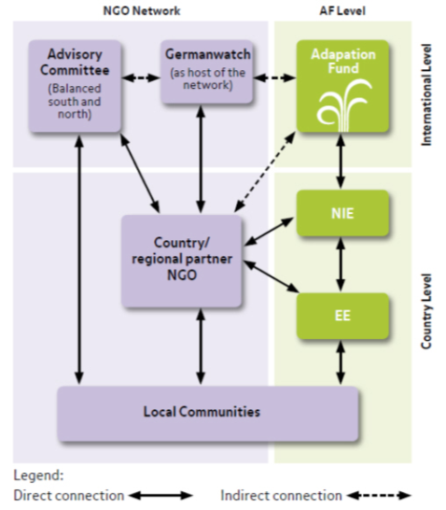
Engagement with Civil Society
Independent NGO/CSO network set up by Germanwatch and includes South & North NGOs following AF projects/programmes
Provides a formal space to represent the community voice at the highest level, at AF Board dialogue at each meeting (3 per yr)
Has allowed AF to achieve high transparency e.g. now publishing every review and document online
www.AF-network.org

Slide 9
International Recognition
2012 Aid Transparency Index: the Fund ranked 17th out 72 institutions overall
Ranked 1st among climate change finance institutions
http://www.publishwhatuoufound.org/index/2012-index/

Slide 10
Outline of Presentation
Overview of Adaptation Fund
Commitment to Transparency and Accountability
Continuous Improvement

Slide 11

At its 20th meeting, April 2013, the Board decided to take the necessary steps for the fund to comply to IATI standards
On April 17, 2013, the AF is the 1st climate finance institution to sign on to the initiative

Slide 12
Access to Data
AF deployed an interactive mapping tool on its website, giving users full access to data (in accessible easy to navigate format)
AF is aiming to publish IATI compatible data by the end of September 2013

Slide 13
Open Information Policy
In July 2013, the Board adopted an Open Information Policy:
  Disclose information unless there is a compelling reason for confidentiality
  Proactive disclosure:
    Working documents of Board meetings
    Committee reports
    Project/programme proposals and reviews

Slide 14
Licensing Policy
In July 2013, the Board also adopted a Licensing Policy:
  Open Data Commons – Attribution License (ODC-BY)
  Users may therefore:
    Share
    Create
    Adapt
  But must attribute (give credit to the Fund)
Notes:
Both Open info policy and licensing policy are required when signing onto IATI

Slide 15
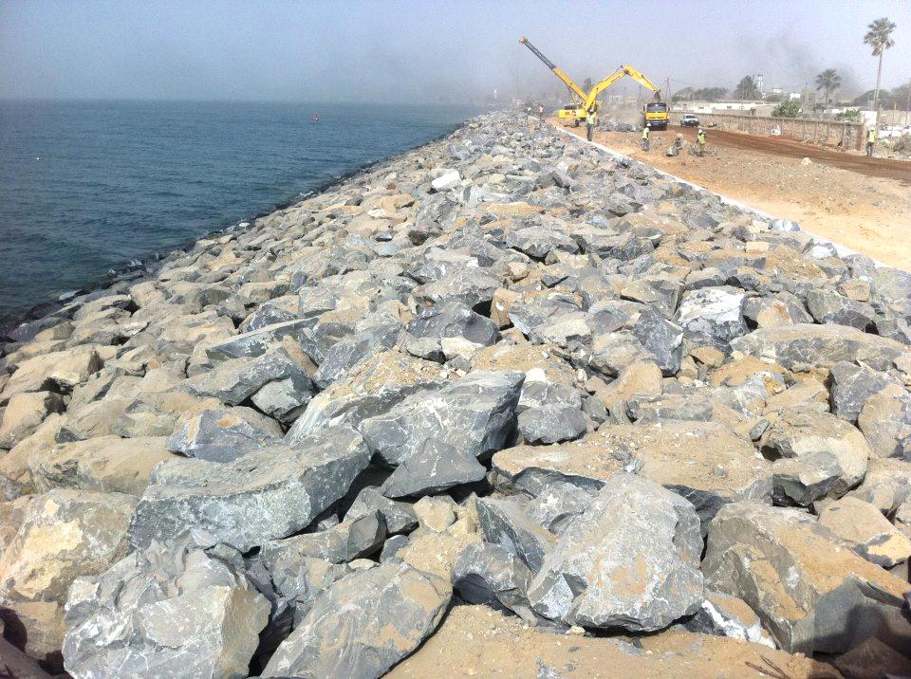


www.adaptation-fund.org
afbsec@adaptation-fund.org
adaptationfund
@adaptationfund
Notes:
Thank you for your attention. Additional information about the AF’s accreditation process and the implementing entities that have been accredited to date are available on our website: www.adaptation-fund.org

