Slide 1
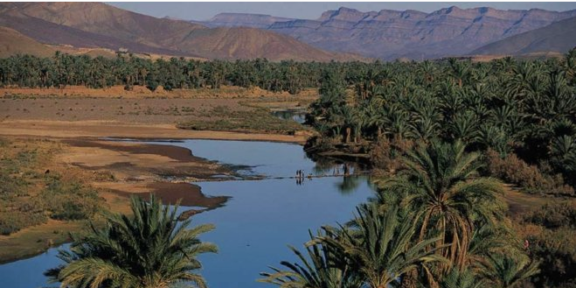
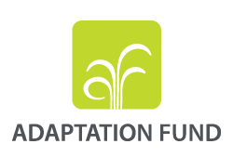
Sécheresses et désertification: quelles mesures d’atténuation et d’adaptation ? Point de vue du d FONDS D’ADAPTATION
Marc-Antoine Martin
Académie de l’Eau – Fonds d’Adaptation
Background and History - 2. Key Points - 3. Strategy - 4. A Concrete Example

Slide 2
Drought and Dersertification linked to CC: what mitigation or adaptation measures ? The view of the Adaptation Fund
Marc-Antoine Martin
Académie de l’Eau – Fonds d’Adaptation
Background and History - 2. Key Points - 3. Strategy - 4. A Concrete Example

Slide 3
1. 1. Main international Funds in the multilateral Climate Finance . Report 2016 UNEP. Adaptation needs US$/y 140 - 300 billion within 2030 versus international public financing for adaptation in developing countries US$ 22.5 billion in 2014
Under UNFCCC: Date operational
Least Developed Countries Fund (LDCF) 2002 MUS$ 991
Special Climate Change Fund (SCCF) 2002 MUS$ 362
Outside of the UNFCCC process:
Pilot Program on Climate Resilience 2008 MUS$ 1200
Under the Kyoto Protocol of UNFCCC:
Adaptation Fund 2009 MUS$ 565
Under the UNFCCC:
Green Climate Fund 2015 billionUS$ 10,26 (50% adaptation)

Slide 4
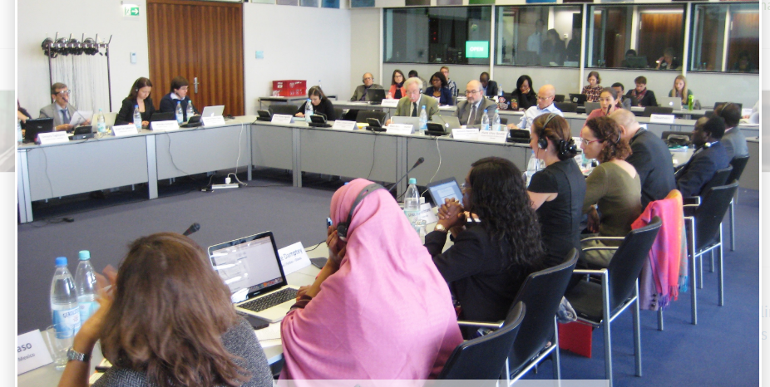
1.3. Adaptation Fund was established under Kyoto Protocol /UNFCCC
Objective
Reduce vulnerability and increase adaptative capacity to respond to the impacts of CC
Goal:
Increase resilience through concrete adaptation projects & programs .
Focus on most vulnerable countries and communities: small island, low-lying coastal, arid and semi arid, areas /floods/ drought and desertification/mountains
Innovative Features:
Governed by majority of developing countries
Levy on Clean Development Mechanism proceeds & other sources of funding
Direct access alongside conventional access through international orgs

Slide 5
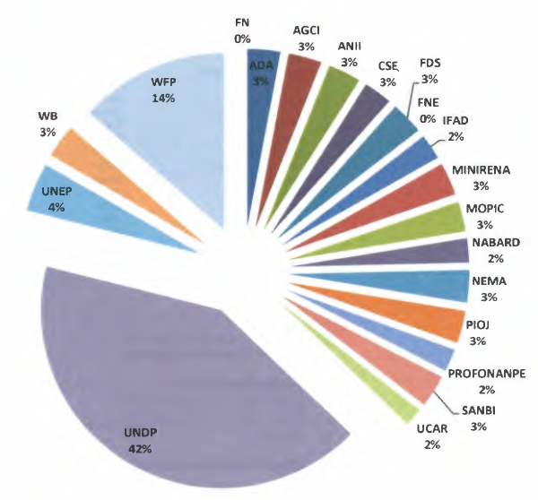
2.1. AF - Main Figures 12 MIE: UNDP, WFP, UNEP, WB, IFAD, UN-HABITAT, WMO, UNESCO... 24 NIE: ... 6 RIE: OSS, BOAD, CAF, CDB, CABEI, SPREP
55 projects/programs
M US$ %
CER sales proceeds 196,6 34,8
Donations & Pledges 362,5 64,2
Inv. Income earned 5,6 1,0
Total Resources 564,7 100,0

Slide 6
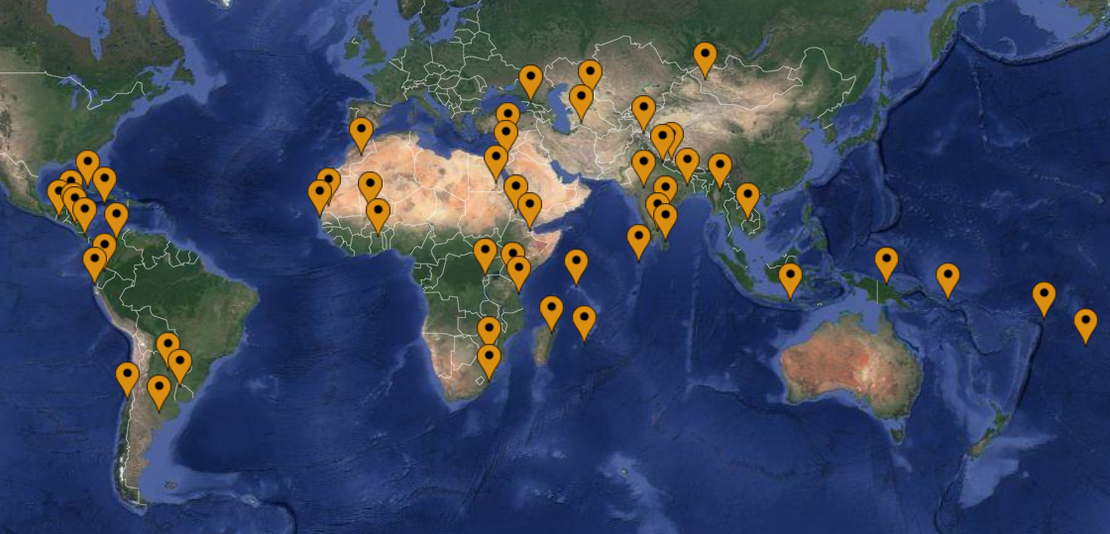
2.2. AF has financed 55 concrete adaptation projects/programs in 63 countries: Grant MUS$ 357,7

Slide 7
3.1. AF – Projects-Programs % Investments by Sectors ( Grants 357,7 M US$ )

Slide 8
3.2. AF - Specific Features
Direct access
Country-drivenness and use of country systems
Expedited decision-making
Enhanced transparency
Performance-based disbursements, and use of results-based management
Involvement of civil society at various levels

Slide 9
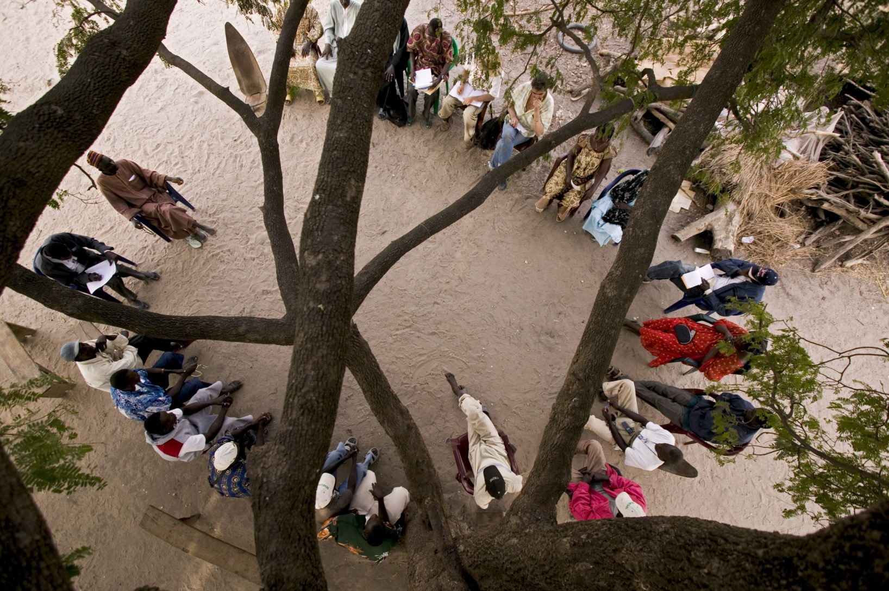
3.3. AF - Transparency and Accountability
All Board documents posted online prior to meeting
All project and program proposals received are considered and reviews disclosed
The Board makes and publishes in its meeting reports a decision about every proposal submitted
Possibility to comment on all proposals online before consideration by Board
All Board meetings are broadcasted live online and are open to observers

Slide 10
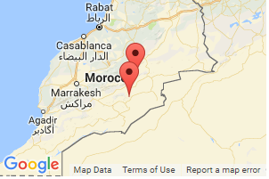
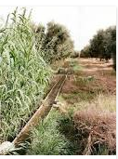
4.1. Climate change adaptation project in oasis zones – Sector : Agriculture – MUS$ 9,98
Oasis zone in southern Morocco 1.733 million inhabitants: overgrazing, excessive water pumping, etc.
Degrading ecosystem - Populations forced to seasonal migration and dependence on the income from migrating.
Abandonment of practices adapted for the oasis zone, and loss of environmental services.
Additional challenge of CC with greater constraints (water scarcity, extreme weather events).

Slide 11
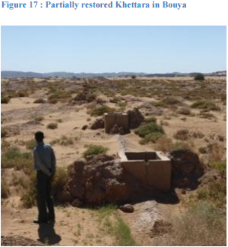
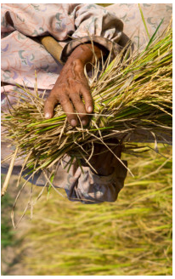
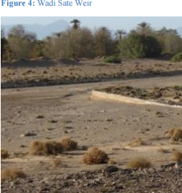
4.2. Climate change adaptation project in oasis zones – MUS$ 9,98 – IE: ADA – 4,5 years – 04 .10.15
Improve adaptability of populations/CC -Objectives:
Improve adaptive capacities of water sector: (US$ 4 279 400): uptstream dams to fill aquifers, Kettarah, seguias…
Diversify income sources and improve living conditions of populations vulnerable to CC in the targeted areas (US$ 1 729 400), argan, cumin (geographical indications), selected dates ,weaving, tourism…
Improve ecosystem’s resilience in response to CC and variability (US$ 1 010 600):ecological agriculture, mud buildings (vs concrete), oasis territorial approach…
Improve awareness of all stakeholders through management and sharing of knowledge (US$ 366 500); associations, cooperatives, local communities, Universities, research centers,…women, young
Strengthen capacities of participants in design and implementation of adaptation measures (US$ 480 000): beneficiaries, communities administration

Slide 12
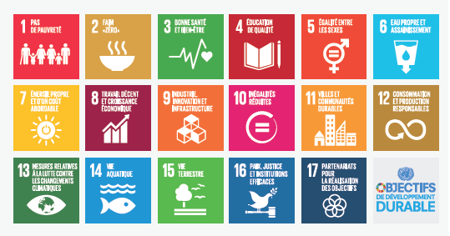
4.2. Climate change adaptation project in oasis zones
Implementing Entity: Agence de Développement de l’Agriculture (ADA)
Executing Entity: Agence de développement des zones oasiennes et de l’arganier (ANDZOA)
Consistent with the Morocco Green Plan and the 2030 SDGs (13, 12, 6, 5)

Slide 13
www.adaptation-fund.org
Merci
شكرا
Thank You

